Slide 1
Named Data Approach for Delay Tolerant Network
Jonathan

Slide 2
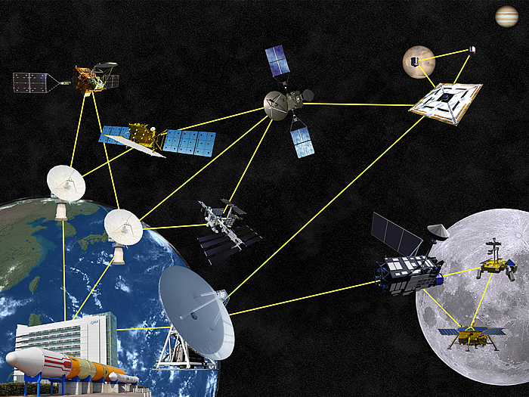
DTN Network
Originally designed for InterPlanetary Internet(IPN).
Lacking continuous end-to-end connection among nodes.

Slide 3
Traditional Routing Protocol
Replicated-based protocol
Epidemic routing
Probabilistic Routing Protocol using the History of Encounters and Transitivity(PRoPHET) routing protocol
Spray-and-Wait protocol

Slide 4
Common Problems
Several copies of messages in the network in order to improve the probability of successful message delivery.
An unnecessary waste of node resource and internet resource.
Many approaches lack the capability of garbage collection.

Slide 5
Named Data Approach
Many DTNs is information-centric in nature.
Makes data reusable.

